Slide 1

Wildfly Swarm
Dima Ionut Daniel

Slide 2
Contents
What is Wildfly Swarm ?
Microservices
Features
Concepts
Core
Fractions
Uberjar
Container
ShrinkWrap
Packing
Configuration
Bibliography

Slide 3

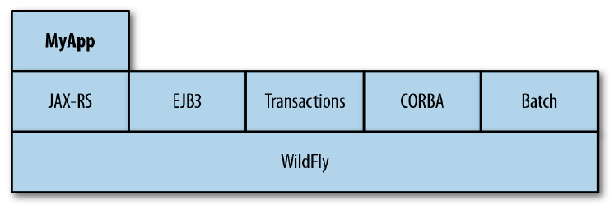
What is Wildfly Swarm ?
WildFly Swarm is a the WildFly application server turned into reusable components called fractions that can be assembled into a microservice application using Java EE APIs.
The application server provides a single point for managing, deploying, configuring multiple application within a single instance.
WildFly Swarm evaluates the pom.xml(or Gradle file) and determines what JavaEE dependencies the microservice uses(servlet, EJB, messaging, CDI, JAX-RS, etc) and then builds tan uber JAR that includes the minimal JAVA EE APIs and implementations for running the service.

Slide 4
What is Wildfly Swarm ? (cont.)
WildFly is a light weight, flexible, feature rich, Java EE 7 compliant application server.
WildFly 9 even introduced a 27MB Servlet-only distribution.
These are very well suited for enterprise and web applications.

Slide 5
Microservices
Microservices are a more concrete and modern interpretation of service-oriented architectures (SOA) used to build distributed software systems.
Services in a microservice architecture (MSA) are processes that communicate with each other over a network in order to fulfill a goal.
MSA is an approach to building software systems that decomposes business domain models into smaller systems.

Slide 6
Features
Simple Upgrades
Build your UberJAR downloading the WildFly artifacts from a repository (Maven) that is designed to be available and accessed by your build scripts.
Permissions aren’t an issue because you are working with a single file most likely being deployed to a container service.
Configuration settings are built into the JAR at build time.
The JAR is the application. Running the JAR means your app is deployed.

Slide 7
Features (cont.)
Typesafe Configuration
The default XML files shipped with the WildFly application server contain a lot of settings.
In practice we start with this default configuration and tweak it.
If we have tweaked the XML directly, then we are left to diff the config files between versions and import the new default settings into your custom XML file

Slide 8
Features (cont.)
Infrastructure as Code
A Java EE application server is designed to provide the basis for Java applications.
WildFly Swarm places the configuration of the application server back in the developer’s court.
WildFly Swarm is just a suite of Java libraries, configured with Java code, compiled with Java tools, and packaged into a Java executable

Slide 9
Features (cont.)
Immutable Deployments
Individual WildFly Swarm deployments are immutable by default.
Deploying the JAR is effectively the same as deploying, and configuring the app server and then deploying a single application.
By using WildFly Swarm we can get immutable deployments of standalone applications.

Slide 10
Concepts
Fraction:
collection of capabilities to add. A fraction can map directly to a subsystem from WildFly, but in other cases (e.g. Jolokia) a fraction may involve different functionality.
Uberjar:
self-contained, executable Java archive. It's a single .jar file containing your application, the portions of WildFly required to support it, an internal Maven repository of dependencies, plus a shim to bootstrap it all.
Hollow Uberjar:
self-contained, executable Java archive that contains no application code. It's a container capable of deploying a particular type of application.
Default Deployment:
primary application artifact created by your Maven or Gradle build. This may be a .war in many cases or a .jar, depending on the <packaging> in your pom.xml

Slide 11
Core
There are 3 ways to start working with WildFly Swarm.
using from scratch maven or gradle project add dependencies and maven plugins
using WildFly Swarm Generator web console (http://wildfly-swarm.io/generator/)
using JBoss Forge tool to generate Java project

Slide 12

Core (cont.)
We start Forge, add the wildfly-swarm addon and generate a new project.
The command project-new will start a wizard process.
The rest-setup command will add JAX-RS to the application.
The rest-new-endpoint command can be used to create JAX-RS endpoints.
The wildfly-swarm-run command will build and run the maven project.

Slide 13
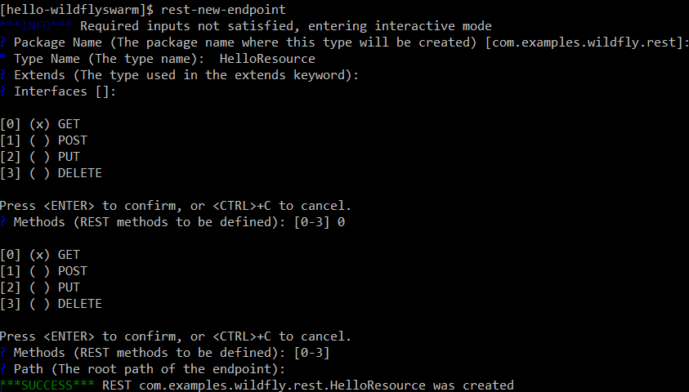
Core (cont.)

Slide 14
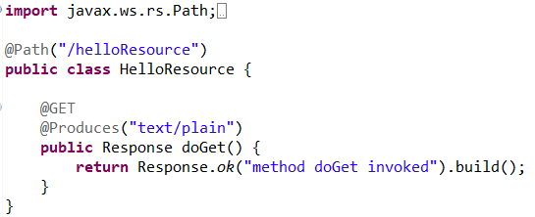
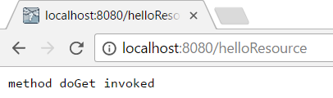
Core (cont.)
After we run the Forge commands we will get bellow class:

Slide 15
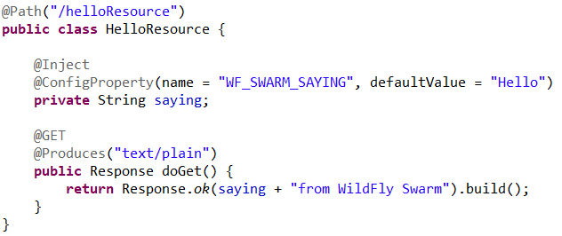
Core (cont.)
We can use external configuration if we add frameworks like Apache Commons Configuration and Apache DeltaSpike Configuration.
Apacge DeltaSpike is a collection of CDI extensions that can be used for configuration, data access, security.
We create a file into META-INF/apache-deltaspike.properties

Slide 16
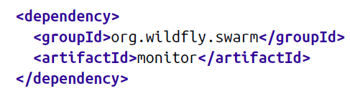
Core (cont.)
We can expose metrics adding the bellow dependency.
WildFly Swarm exposes some basic metrics like:
information about the node on which WildFly Swarm is running using the path /node.
JVM heap usage using the path /heap.
JVM/process thread information using the path /threads.

Slide 17
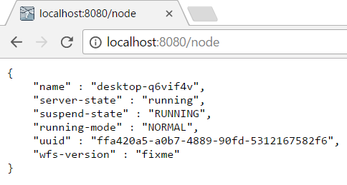
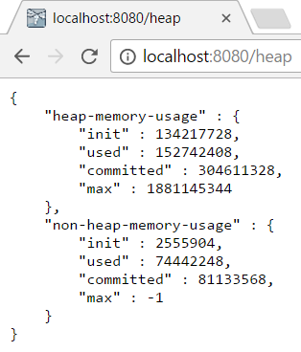
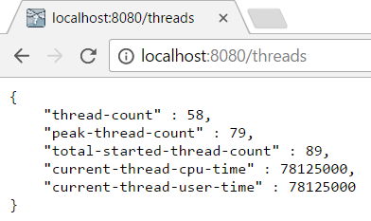
Core (cont.)

Slide 18
Core (cont.)
If we need to run the project outside maven we need to run:
mvn clean install wildfly-swarm:run

Slide 19
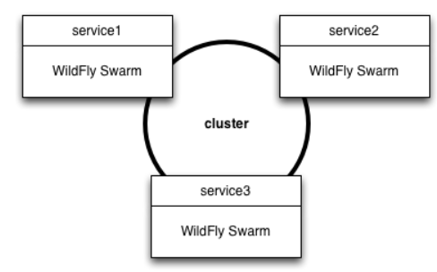
Core (cont.)
WildFly Swarm uses the same subsystem but to a different end.
With a cluster of WildFly Swarm services, each service may be unique and distinct.
Clustering, in tandem with the Topology fraction, serves to assist in discovery of other services.

Slide 20
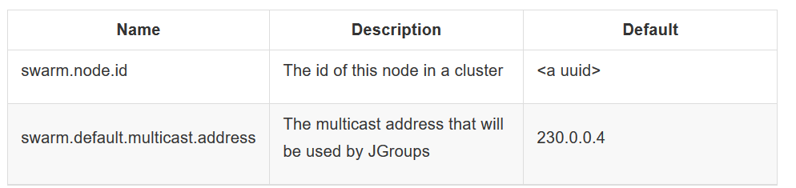
Core (cont.)
To enable clustering, the jgroups dependency is required.
The WildFly clustering functionality is built upon JGroups, a reliable group communications stack.
By default, it uses IP multicast to locate other members of the cluster.
In environments where multicast is not supported, other components may be used.

Slide 21
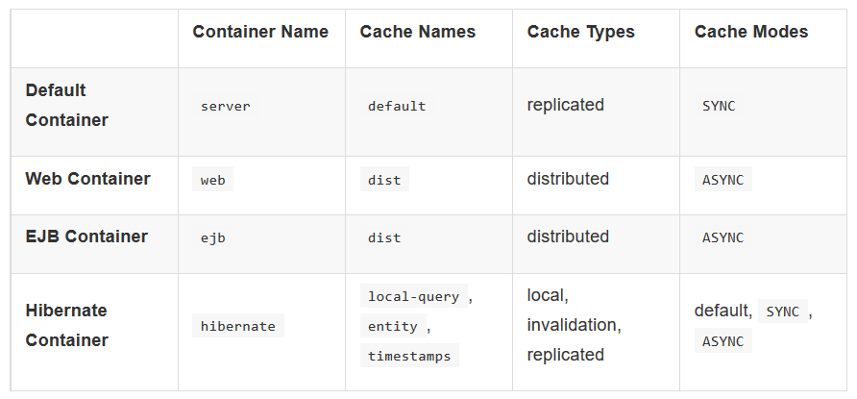
Core (cont.)
The Infinispan subsystem provides high-performance, clustered, transactional caching.
in a clustered web application, client session identifiers and/or data may need to be replicated across all nodes in the cluster.
The failure of a session-oriented HTTP request requires that client session data is available on the new failover node.
By default, the Infinispan fraction is configured with four cache containers.

Slide 22
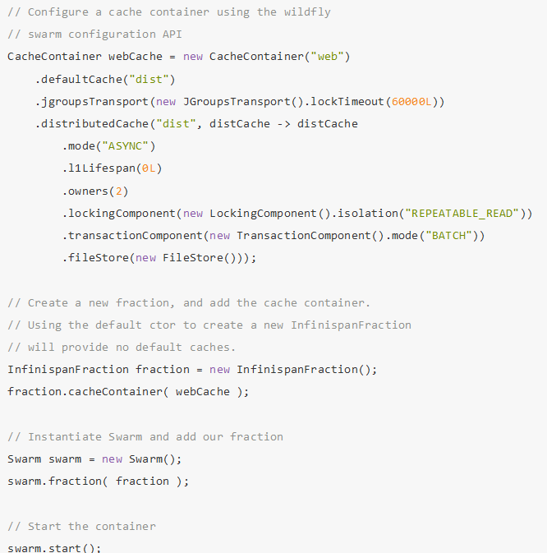
Core (cont.)

Slide 23
Fractions
Wildfly Swarm compositional units
Focus on serving specific use cases
Define dependencies to other fractions
Tie together:
metadata
modules
deployments
subsystems

Slide 24
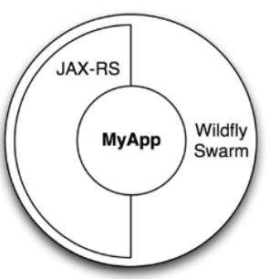
Uberjar
A single .jar file containing the application
The portions of Wildfly required to support it
An internal Maven repository of dependencies
An entry point to bootstrap the application

Slide 25
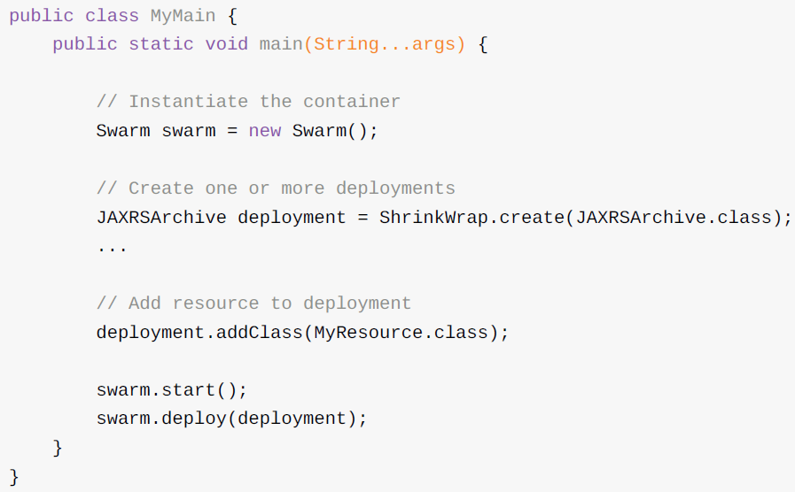
Container
At the root of every WildFly Swarm application is the container.
The container provides an API for instantiating an embedded WildFly Swarm container, starting and stopping it, and deploying.

Slide 26
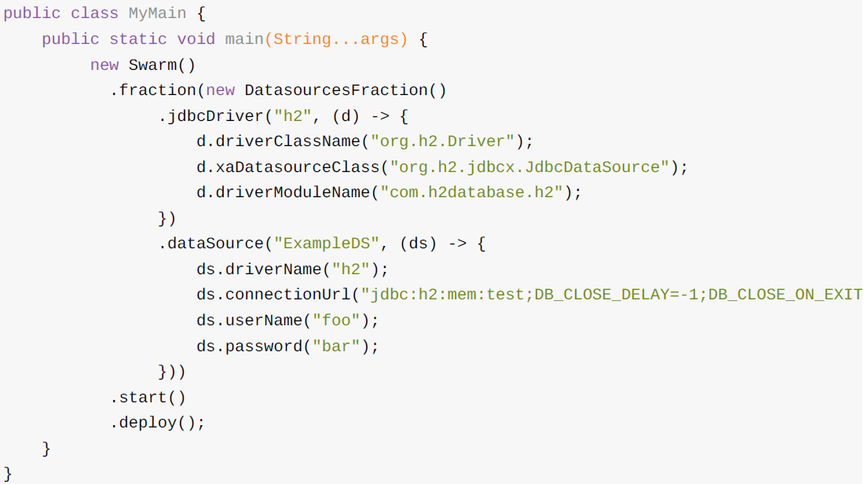
Container (cont.)
If we only need to do some configuration of the container without needing to manipulate the deployment archive, we can call deploy() with no arguments to have it deploy the default archive.

Slide 27
ShrinkWrap
ShrinkWrap is an open-source project sponsored by Red Hat.
It provides an API and SPI for easily creating, importing, exporting and manipulating archives.
ShrinkWrap works in memory, but can also be used to create archives on disk.

Slide 28
ShrinkWrap (cont.)
The primary entry-point into ShrinkWrap is the ShrinkWrap class and its create(class) method.
We can create simple Java or Web archives ( .jar and .war , respectively) by passing JavaArchive.class or WebArchive.class to the create(… ) method.
WildFly Swarm additionally makes other types of archives available, depending on which fractions you include in your application.

Slide 29
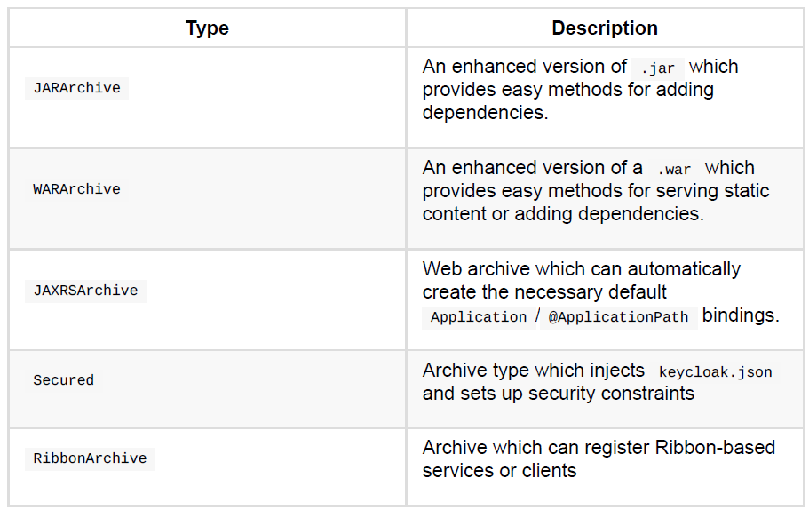
ShrinkWrap (cont.)

Slide 30
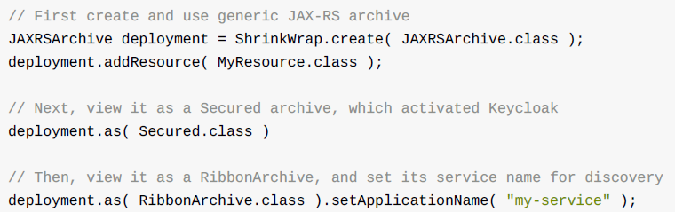
ShrinkWrap (cont.)
Each ShrinkWrap archive type is effectively a view onto the underlying archive.
Using the archive’s own .as(class) method, the view can be changed several times while constructing it.

Slide 31
Packing
When the application is packaged as a .jar , we can also provide the main(… ) method.
If we have an existing WAR-based application, we can construct a self-contained myappswarm.jar from it with ease.
By using the plugin of your choice (Maven or Gradle), the resulting uberjar will contain your application along with enough of the application-server to support it.
In Maven project(pom.xml) we define <packaging>war</packaging> and we add the configuration
<build>
<plugins>
<plugin>
<groupId>org.wildfly.swarm</groupId>
<artifactId>wildfly-swarm-plugin</artifactId>
</plugin>
</plugins>
</build>

Slide 32
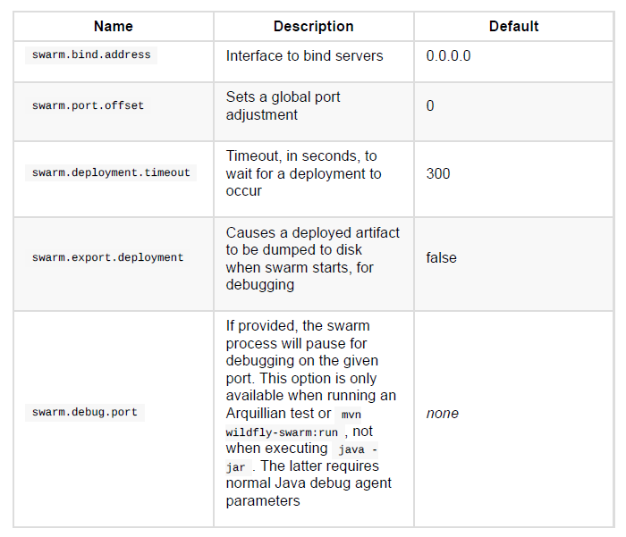
Configuration (cont.)
Below is a non-exhaustive set of useful properties, which may be available depending on which fractions your application uses.

Slide 33
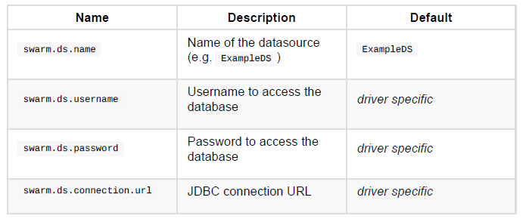
Configuration (cont.)
For the H2, MySQL and Postgres database fractions, the follow properties are supported to
configure the datasource.

Slide 34
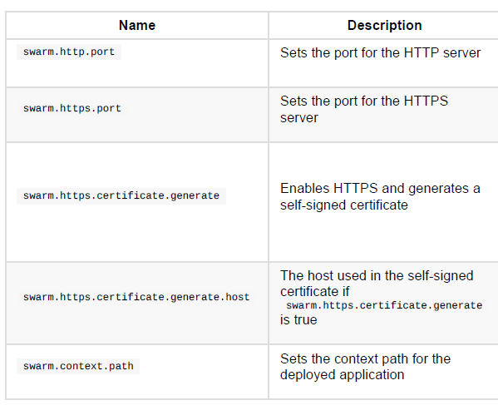
Configuration (cont.)
Undertow configuration

Slide 35
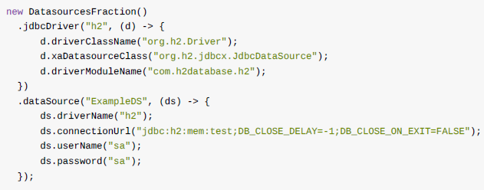
Configuration (cont.)
The Java API is most straight forward way to configure fractions in WildFly Swarm.

Slide 36
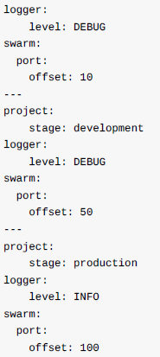
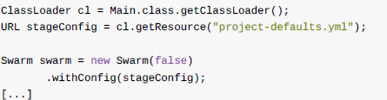
Configuration (cont.)
We can use configuration in YAML format.

Slide 37
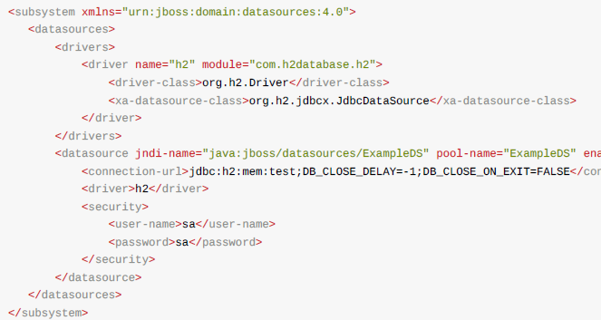
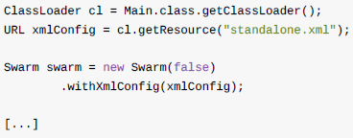
Configuration (cont.)
We can use configuration in XML format.

Slide 38

Bibliography
https://en.wikipedia.org/wiki/Microservices
http://wildfly-swarm.io/
http://blog.arungupta.me/wildfly-swarm-microservices-javaee/
https://www.slideshare.net/dandreadis/wildfly-wildfly-swarm
https://dzone.com/articles/top-reasons-to-consider-switching-to-wildfly-swarm
Wildfly Swarm Users Guide

